Slide 1

4 keys of fun, genre, demographic, theme
Demographic
15-24-year-old males
ACCORDING TO The NPD Group/ Retail Tracking Service/ Digital Games Tracking Service THE BEST SELLING VIDEO GAME GENRES IN 2016 WERE SHOOTERS WITH 27.5% FOLLWED BY ACTION GAMES WITH 22.5%.
based on Q4 of the UK games industry in 2016 (Luke, 2016) the largest demographic is 15-24-year-old males so it would be best to hit the largest target audience possible
Genre
Toss Game
4 Key of fun
Hard Fun, people fun
Theme
Action based

Slide 2
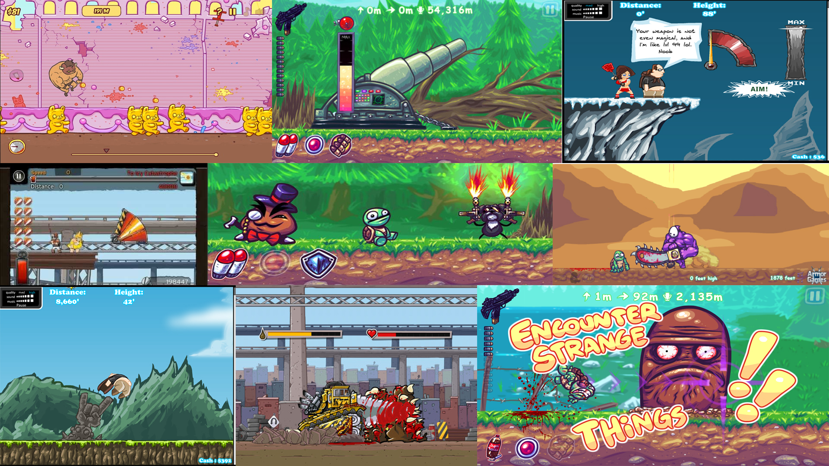
Mood-board

Slide 3




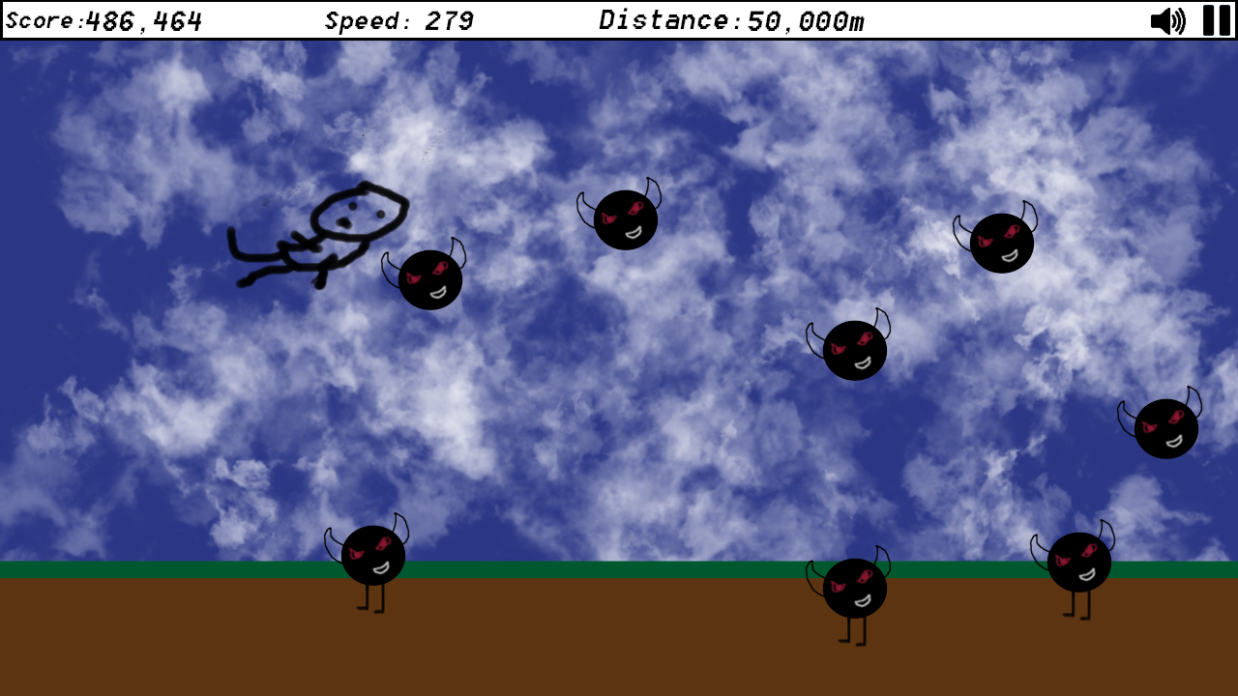
Concept art

Slide 4
Unique Selling Points
2.5D character and enemies to make them stand out from the background.
Allowing the user to add their own background music
Achievements that have puns based on what you have to do

Slide 5
References
Schell, J. (2015). The art of game design. 2nd ed. Boca Raton: CRC Press, p.101.
Lofgren, K. (2017). 2017 Video Game Trends and Statistics - Who's Playing What and Why?. [online] Big Fish Games. Available at: http://www.bigfishgames.com/blog/2017-video-game-trends-and-statistics-whos-playing-what-and-why/ [Accessed 8 Oct. 2017].
http://www.theesa.com/wp-content/uploads/2017/04/EF2017_FinalDigital.pdf
Luke. (2016). The games industry in numbers. Available: https://ukie.org.uk/sites/default/files/UK%20Games%20Industry%20Fact%20Sheet%2010%20August%202017.pdf. Last accessed 03/10/2017

